Slide 1

Phonics, reading
and writing

Slide 2
Introduction
Spoken words are made up of different sounds. We learn to match these sounds to letters. There are 44 sounds in the English language represented by 26 letters of the alphabet.
Phonics is about children knowing how letters link to sounds. We teach the children if you see this letter it makes this sound & if you hear this sound you write this letter.
The children then use this when they are reading and writing.

Slide 3
Unlocking Letters and Sounds
We follow the scheme Unlocking Letters and Sounds (ULS).
Approved government scheme
Before they start phase 1 phonics
Tuning into sounds
Listening activities
Oral blending and segmenting
Rhyming activities
Alliteration tongue twisters

Slide 4


Phoneme: The smallest unit of sound in a word.
a
Grapheme: The letter or letters that represent the phoneme.
or
Digraph: two letters that make the same sound.
igh
trigraph: three letters that make the same sound.

Slide 5
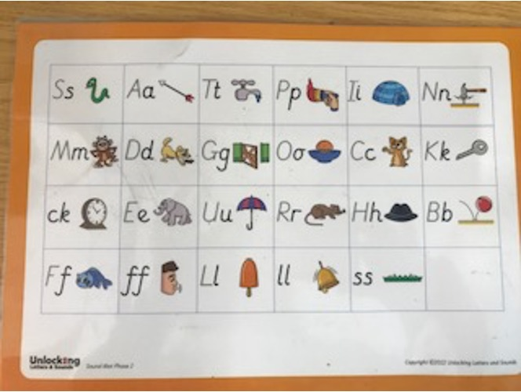
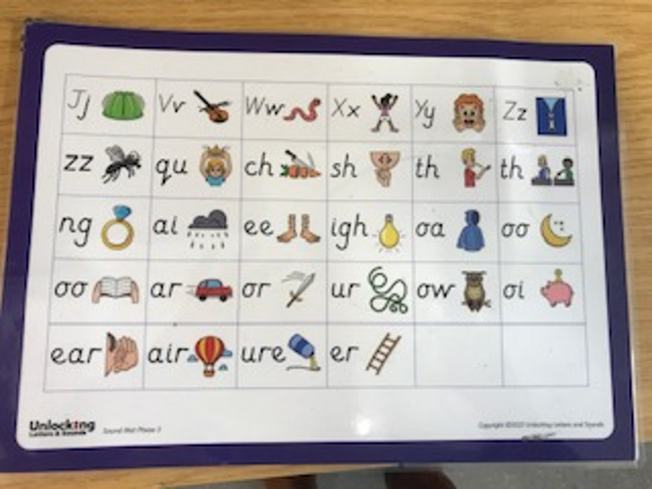
Pronunciation of sounds
Link to video clip

Slide 6
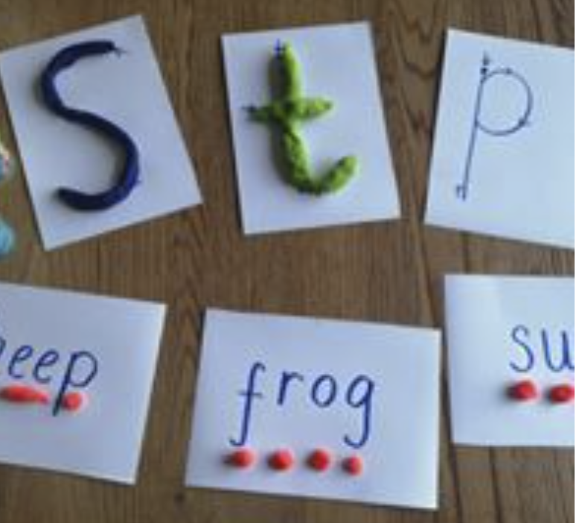
Blending
Blending to read
Putting sounds together to read words.
We start with oral blending (pretend to be a robot, can you get your c-oa-t.)
We move on to looking at a word and blending the sounds.

Slide 7
cat
book
sun
light

Slide 8
Segmenting
Segmenting to spell
Splitting the word up into individual sounds so we can write it.
Phoneme fingers

Slide 9
Common Exception Words
Words that cannot be sounded out (tricky words)
https://www.youtube.com/watch?v=TvMyssfAUx0
the
I to
go
no

Slide 10
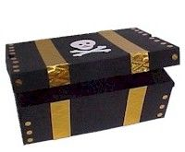
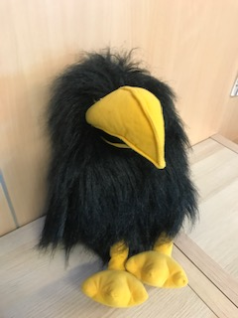

Making it fun!
Songs and rhymes.
Games.
Writing on our heads.
Squawk the puppet.
Go on a treasure hunt, reading clues along the way.
Target practise: Hit the grapheme or word with the football or with a spray/fly swat!
Go on a sound hunt in the garden or around the house.

Slide 11
Book bags
We will send home the sounds we have learnt in a clear pencil case each week. You can use these for word building.
As and when your child is ready we will send decodable books for your child to read at home.
One book at a time for you to read and reread with your child, so they become confident reading it. The focus is confidence and fluency rather than rushing and reading lots of books.

Slide 12
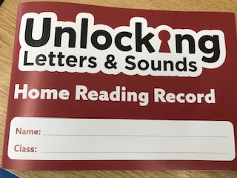
​
Your child will have their own reading record for you and us to write in.​
Your child will have a reading day which is when we will hear them read at school but please bring reading books each day.
Lots of reading activities will be taking place all week.

Slide 13
How can I help my child at home?
Build 5/10 minutes into your routine to spend practising the sounds/common exception words.
Little and often works best!
Read the school phonics reading book at least 2 times.
Please write in the reading record.
Continue to share a book at bedtime.

Slide 14
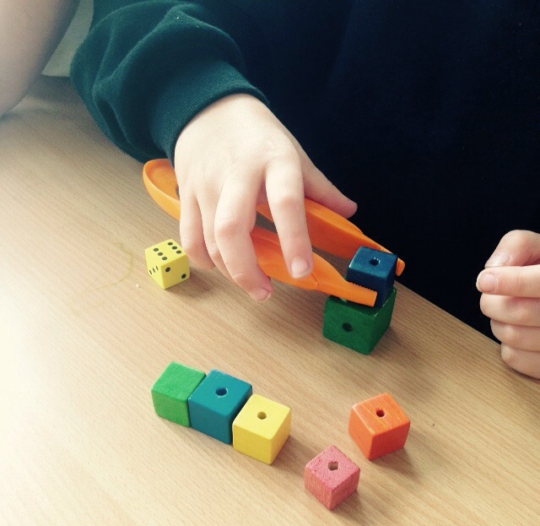
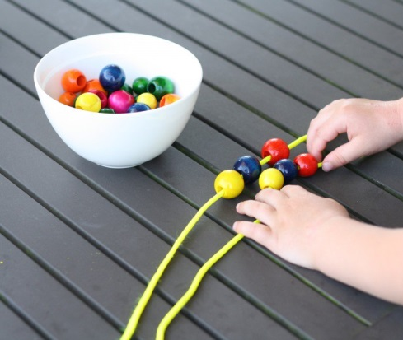
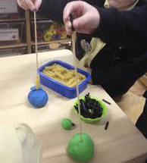
Fine motor skills
Young children need to develop the muscles in their fingers before they can hold a pencil properly.

Slide 15

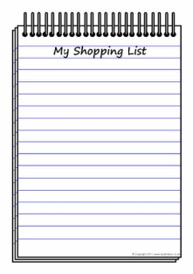

Writing at home
Praise your child for ‘play writing’.
Write with your child- ‘think out loud’
Spellings- phonetically spelt.
Encourage correct formation of letters and lowercase
Give your child a purpose for writing:
Send an email to family
Write a birthday card
Writing labels
Write a shopping list
Treasure maps

Slide 16
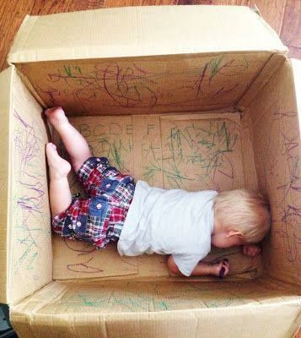
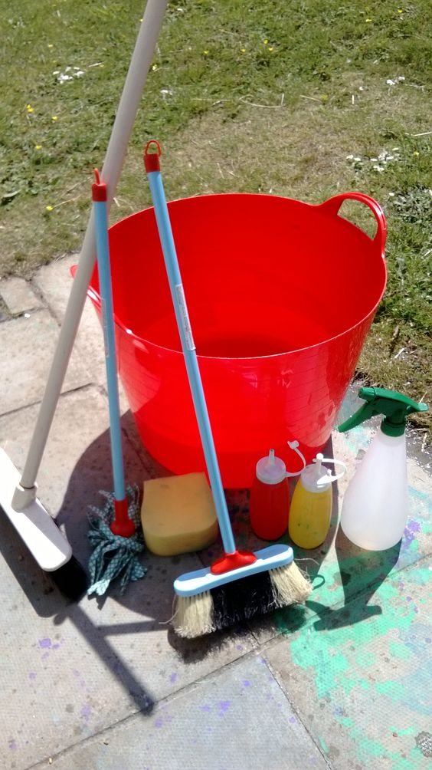
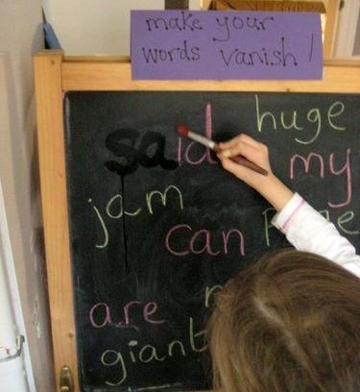
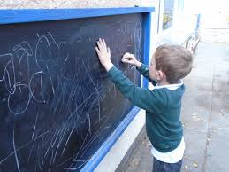
Make writing fun!

Slide 17
Useful websites
Oxford Owl
www.oxfordowl.co.uk/for-home/phonics-made-easy
Phonics play
www.phonicsplay.co.uk
Teach your monster to read
www.teachyourmonstertoread.com
Letters and sounds
http://www.letters-and-sounds.com/
Phonics Family
https://phonicsfamilycom.wordpress.com

