Slide 1
Phonics in Year 1. Now it gets tricky!
It’s exciting and fun!
Can we crack the code?

Slide 4
We explore digraphs (2 letters making 1 sound) and trigraphs (3 letters making one sound.)
We find out that one sound can be represented by different groups of letters: igh, i-e, y, ie

Slide 5
Alternative pronunciations
c as in cat, then c as in rice, ice (soft c)
g as in get , then g as in cage, George
i as in tin, then i as in find
ch as in chin, then ch as in school.

Slide 6
Split digraphs
Two letters are together making one sound (digraph), another letter pushes in between them and splits them up but they still make their sound.
Split digraphs are also known as Magic e or Bossy e
The e makes the vowel say its name not its sound. bake like joke
https://www.twinkl.co.uk/teaching-wiki/split-digraph

Slide 7
Spelling We learn best fit spellings. For example, oi oy make the same sound in words but which spelling choice do we use in our writing?
boi boy
Rules: which is used the most.
where in the word is the spelling choice
used (middle, end.)

Slide 8
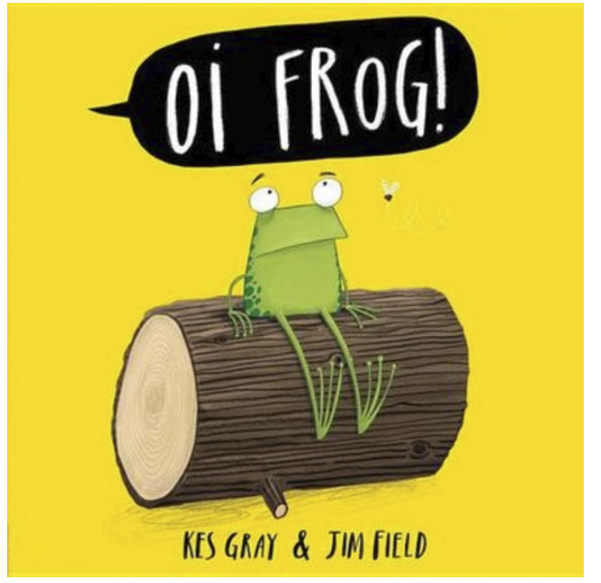
The more you read the easier it gets to spot patterns and see words in your mind.
Real books: ai Snail and the whale oi Oi frog, Oi dog, Oi cat ow The smartest giant in town

Slide 11
Year One Phonic Check
The Phonic Screen takes place in June.
The children will be given 40 words to read.
The words will be a mix of real words and alien words.
If a child does not pass the phonic check then they take it again in Year 2.

Slide 12
Example Phonic Check

Slide 13
Common Exception words(CEW)
We learn to read and spell CEW They are not phonetic, they just have to be learnt.
said they are
In the class Squawk our puppet is used to help the children learn to read and spell tricky words. He plays silly games with the words and then the words are displayed on Squawk’s wall for children to use.
Youtube: Tricky word songs https://www.youtube.com/watch?v=R087lYrRpgY

Slide 14
Expectations for Year 1
Writing can be read without mediation from others.
Writing is phonetically plausible.
Some tricky words (common exception words) are spelt correctly
Days of the week are spelt correctly
Letters formed correctly

Slide 15
Useful websites
www.phonicsbloom.co.uk
www.galacticphonics.com
www.letters-and-sounds.com
https://home.oxfordowl.co.uk/reading/learn-to-read-phonics/

