Slide 1
Phonics, reading
and writing

Slide 2
Introduction
Children develop awareness of different sounds in spoken language from a very early age.
Spoken words are made up of different sounds. They learn to match these sounds to letters.
Phonics is about children knowing how letters link to sounds.
The children then use this when they are reading and writing.

Slide 3
Unlocking Letters and Sounds
We follow the scheme Unlocking Letters and Sounds (ULS).
Approved government scheme
Before they start phase 1 phonics
Tuning into sounds
Listening activities
Oral blending and segmenting
Rhyming activities
Aliteration tongue twisters

Slide 4
Phoneme: The smallest unit of sound in a word.
a
Grapheme: The letter or letters that represent the phoneme.
or
Digraph: two letters that make the same sound.
igh
trigraph: three letters that make the same sound.

Slide 5
a
oo
s
sh
or
igh
ai
ee
Pronunciation of sounds
Link to video clip

Slide 6
cat
book
sail
light

Slide 7
blending
Blending to read
Putting the sounds together to read words
Play Metal Mike/robot talking game for oral segmentation
p-o-t
m-a-t

Slide 8
segmenting
Segmenting to spell
Splitting the word up into individual sounds

Slide 9
common exception words
Words that cannot be sounded out.
the
I to
go
no

Slide 10
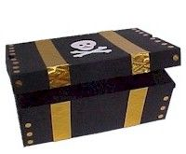
Making it fun! Lots of good ideas on Phonics Family website
Cross the river
What’s in the box?
Metal mike
Go on a treasure hunt, reading clues along the way.
Go on a sound hunt in the garden or around the house.
Target practise: Hit the grapheme or word with the football or with a spray/fly swat!

Slide 11
Book bags
Books to share at home with your child from the blue box in Gruffalo outside area.
As and when your child is ready we will send decodable books for your child to read at home.
One book at a time for you to read and reread with your child, so they become confident reading it. The focus is confidence and fluency rather than rushing and reading lots of books.
We will send home the sounds we have learned in sets in a clear pencil case. You can use these for word building.

Slide 12
How can I help my child at home?
Build 5/10 minutes into your routine to spend practising the sounds/common exception words
Read the school phonics reading book at least 3 times and more if possible
Share a book at bedtime (sharing book from blue box or a favourite from home)
Fact about words vocab

Slide 13
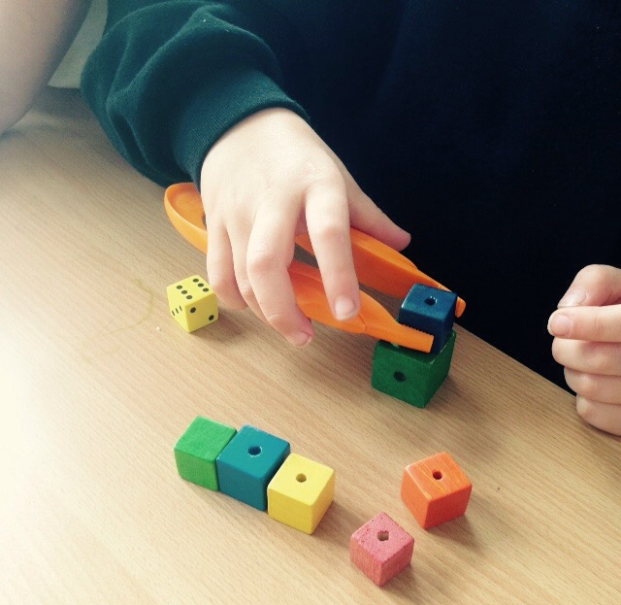
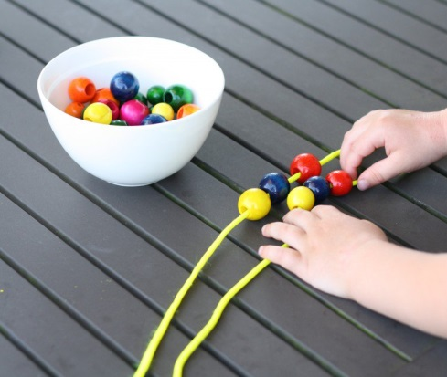
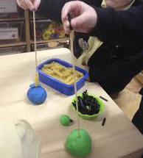
Fine motor skills
Young children need to develop the muscles in their fingers before they can hold a pencil properly.

Slide 14
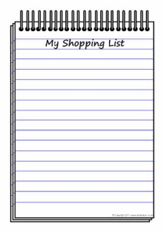
Writing at home
Praise your child for ‘play writing’.
Write with your child- ‘think out loud’
Spellings- phonetically spelt.
Encourage correct formation of letters and lowercase
Give your child a purpose for writing:
Send an email to family
Write a birthday card
Writing labels
Write a shopping list
Treasure maps

Slide 15
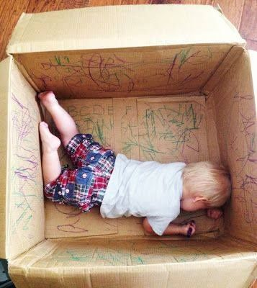
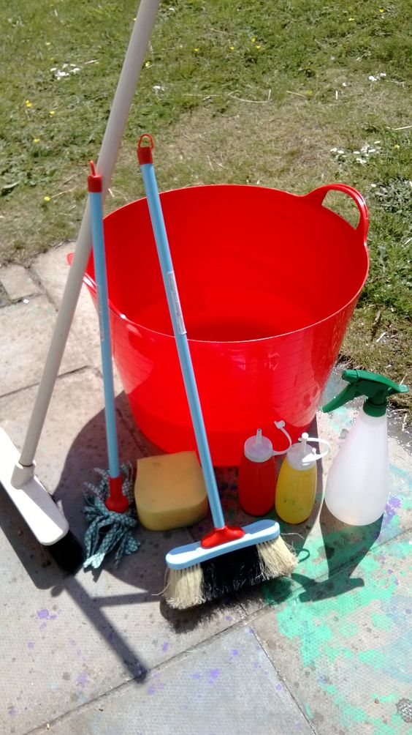
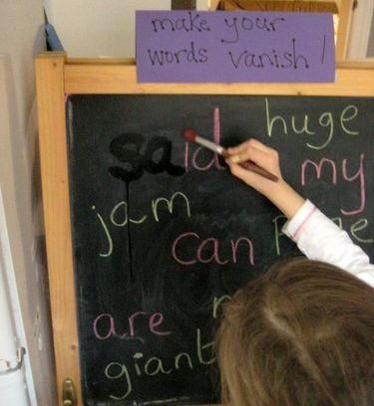
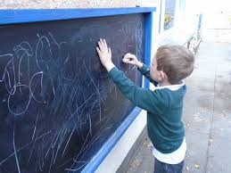
Make writing fun!

Slide 16
Useful websites
Oxford Owl
www.oxfordowl.co.uk/for-home/phonics-made-easy
Phonics play
www.phonicsplay.co.uk
Teach your monster to read
www.teachyourmonstertoread.com
Letters and sounds
http://www.letters-and-sounds.com/
Phonics Family
https://phonicsfamilycom.wordpress.com

